Slide 1

David M. Kroenke and David J. Auer Database Processing: Fundamentals, Design, and Implementation
Chapter Ten C:
Managing Databases with
MySQL 5.6
Part 1: Installing MySQL and Building the Cape Codd Database

Slide 2
Chapter Objectives
To install MySQL 5.6 and create a database
To use the MySQL Workbench graphical utilities
To submit both SQL DDL and DML via the MySQL Workbench
To import Microsoft Excel worksheet data into a database table
To understand the use of SQL/Persistent Stored Modules (SQL\PSM) in MySQL’s variant of SQL
To understand the purpose and role of user-defined functions and know how to create simple user-defined functions

Slide 3
Chapter Objectives
To understand the purpose and role of stored procedures and know how to create simple stored procedures
To understand the purpose and role of triggers and know how to create simple triggers
To understand how MySQL 5.6 implements indexes. concurrency control and cursors
To understand how MySQL 5.6 implements server and database security
To understand the fundamental features of MySQL 5.6 backup and recovery facilities

Slide 4
Scope
The PowerPoint slide show covers the first three objectives.
In particular:
How to install MySQL 5.6.
How to use MySQL Workbench.
How to create a MySQL database.
How to use existing SQL scripts to build and populate the Cape Codd database used for SQL DML work in Chapter 2.

Slide 5
Introduction
There are several versions of MySQL 5.6, and these can be reviewed at www.mysql.com/products/
Of particular interest to us are two versions
MySQL Enterprise—MySQL Enterprise (www.mysql.com/products/enterprise/ ) is a subscription service that includes the MySQL Enterprise Server, MySQL Production Support, and some utilities that are not available as open-source downloads (including the MySQL Enterprise Monitor and MySQL Query Analyzer).
MySQL Community Edition—MySQL Community Edition (formerly MySQL Community Server) (http://dev.mysql.com/downloads/mysql/5.6.html) is the free version of MySQL available for download.
Notes:
Oracle Corporation does not publish a time line for expected release dates of new versions of MySQL. We have been anticipating the release of MySQL 5.7 for some time, but it has remained in milestone development releases since April of 2013.
At the time we are working on this material (April 2015), MySQL 5.7 has just been released as a release candidate version (MySQL 5.7.7 on April 8, 2015), and it is likely that MySQL 5.7 will soon be available as GA software.
We do not include material about software versions that have not been officially released in this book, and so we do not specifically cover MySQL 5.7.
However, we have tested the material in this book with development versions of MySQL 5.7, and all the material in this book about MySQL 5.6 is also directly applicable to MySQL 5.7.

Slide 6
Installing Microsoft SQL Server 2014 Prerequisites – Install These
In order to use the MySQL Installer for Windows, you must have the following products installed:
.Net Framework 3.5
Microsoft Visual C++ Redistributable for Visual Studio 2013
Notes:
.Net Framework 3.5 is provided with the Windows OS, but it may not be enabled by default. In Windows 8.1, use Control Panel | Programs | Programs and Features | Turn Windows Features On or Off to install .Net Framework 3.5. In Windows Server 2012, use Server Manager | Manage | Add Roles and Features to launch the Add Roles and Features Wizard to install .Net Framework 3.5.
.Net Framework 4.5 is provided with the Windows OS and should be enabled by default. In Windows 8.1, use Control Panel | Programs | Programs and Features | Turn Windows Features On or Off to install .Net Framework 4.5. In Windows Server 2012, use Server Manager | Manage | Add Roles and Features to launch the Add Roles and Features Wizard to install .Net Framework 4.5. This will actually be .Net Framework 4.5.1, which is the version provided with Windows 8.1 and Windows Server 2012 R2,
For the other products, download them from http://www.microsoft.com/en-us/download/ .
Download and install the Microsoft Visual C++ Redistributable Package for Visual Studio 2013 (32-bit or 64-bit version depending upon your operating system) from http://www.microsoft.com/en-us/download/details.aspx?id=40784

Slide 7
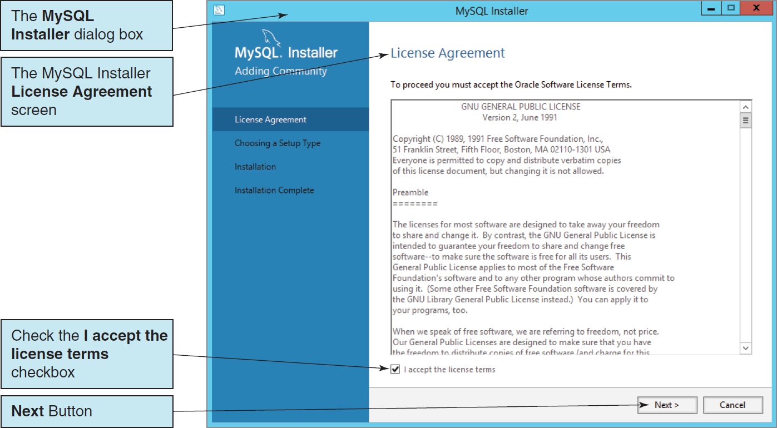
Installing MySQL 5.6 The MySQL Installer License Agreement Screen

Slide 8
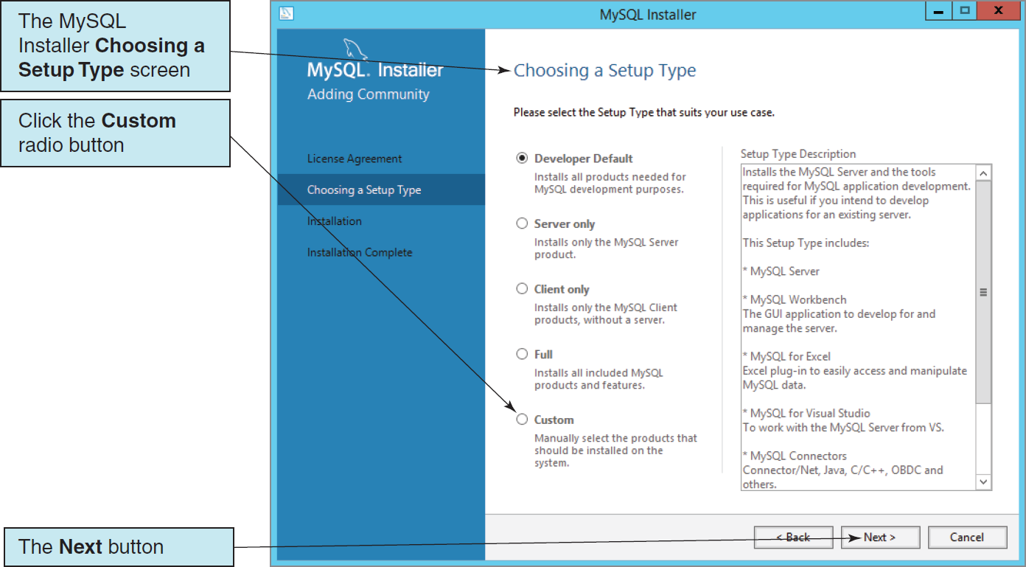
Installing MySQL 5.6 The Choosing a Setup Type Screen

Slide 9
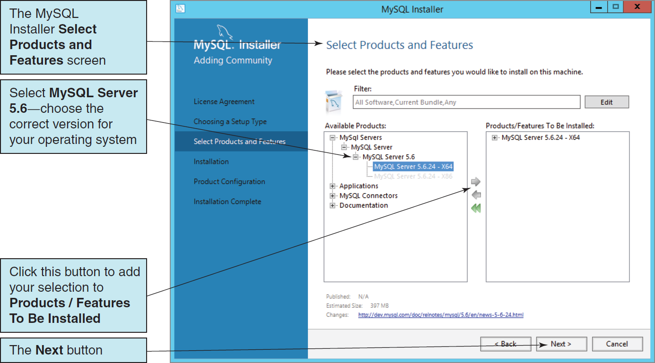
Installing MySQL 5.6 The Select Products and Features Screen - MySQL Servers

Slide 10
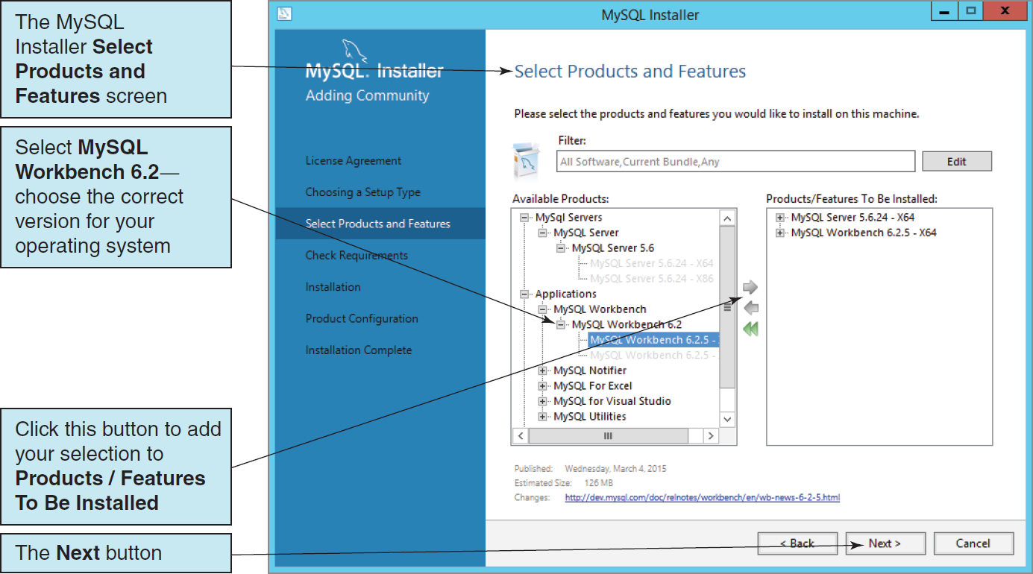
Installing MySQL 5.6 The Select Products and Features Screen - Applications

Slide 11
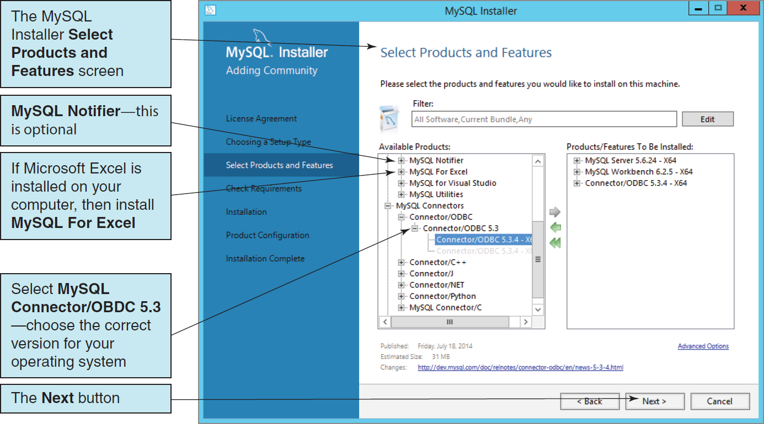
Installing MySQL 5.6 The Select Products and Features Screen – MySQL Connectors

Slide 12
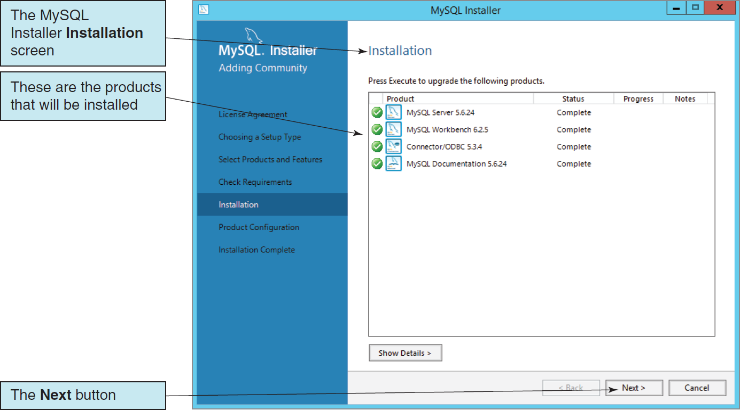
Installing MySQL 5.6 The Installation Screen

Slide 13
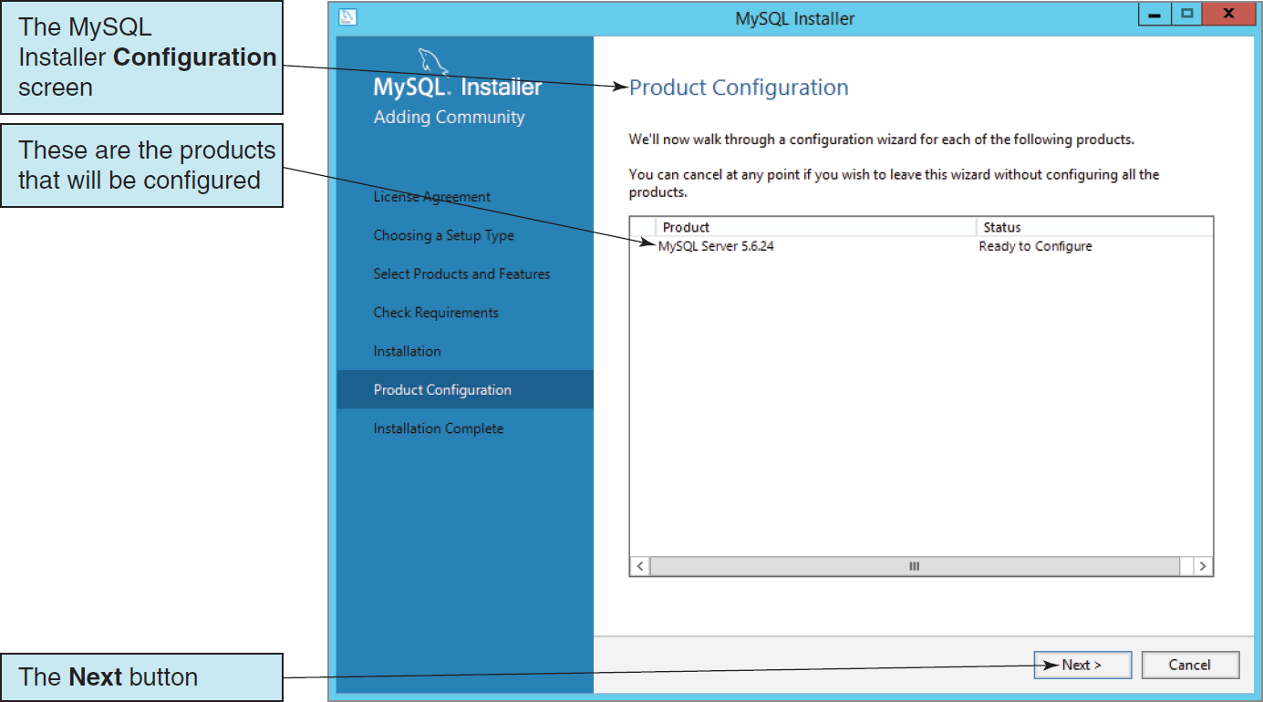
Installing MySQL 5.6 The Product Configuration Screen

Slide 14
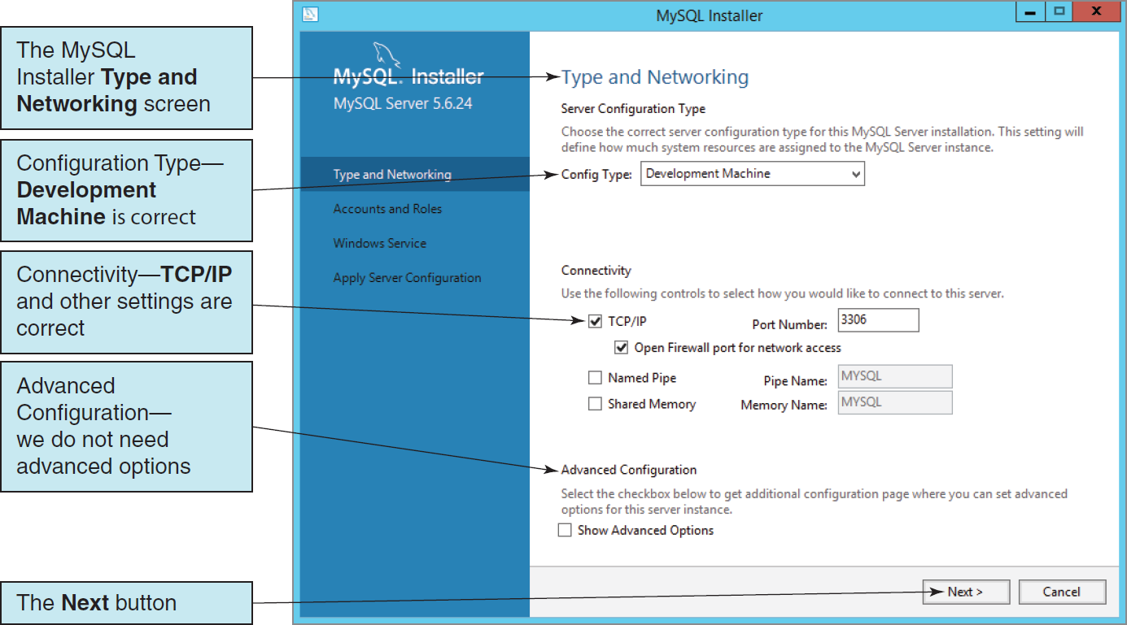
Installing MySQL 5.6 The Type and Networking Screen

Slide 15
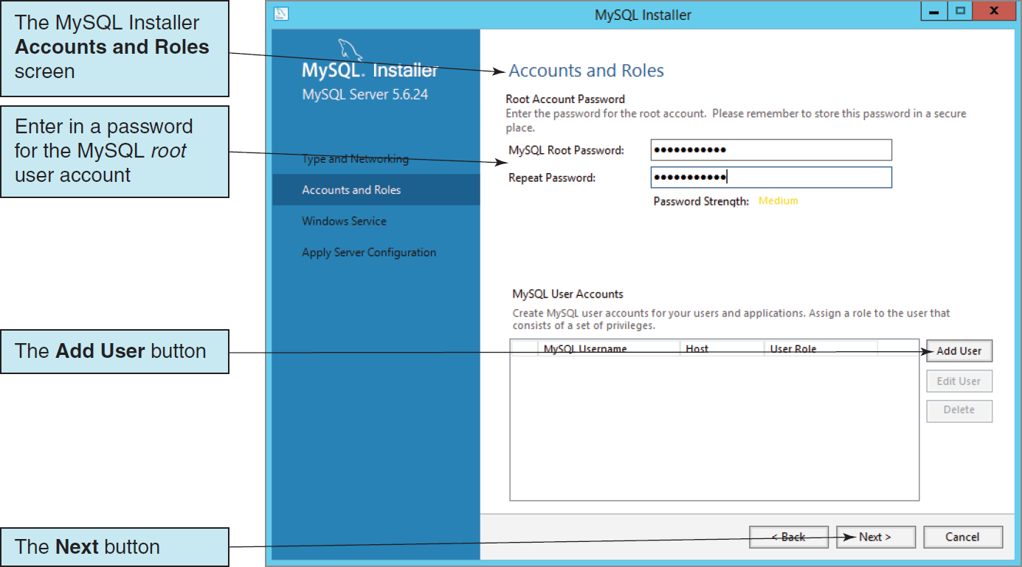
Installing MySQL 5.6 The Account and Roles Screen

Slide 16
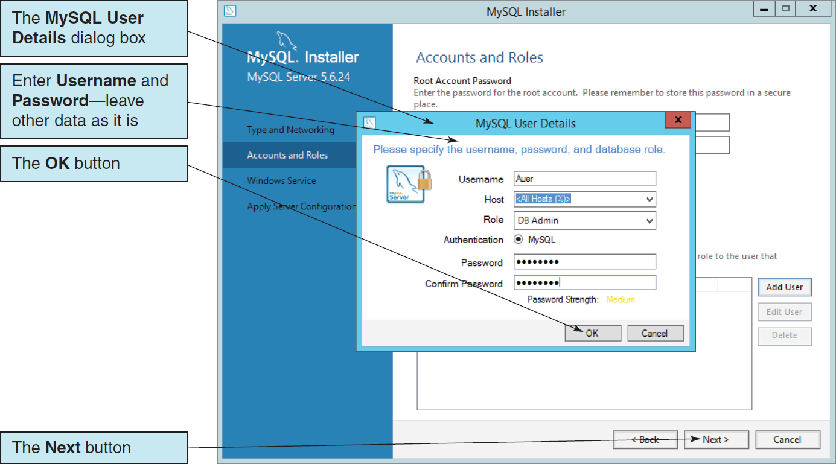
Installing MySQL 5.6 The MySQL User Details Dialog Box

Slide 17
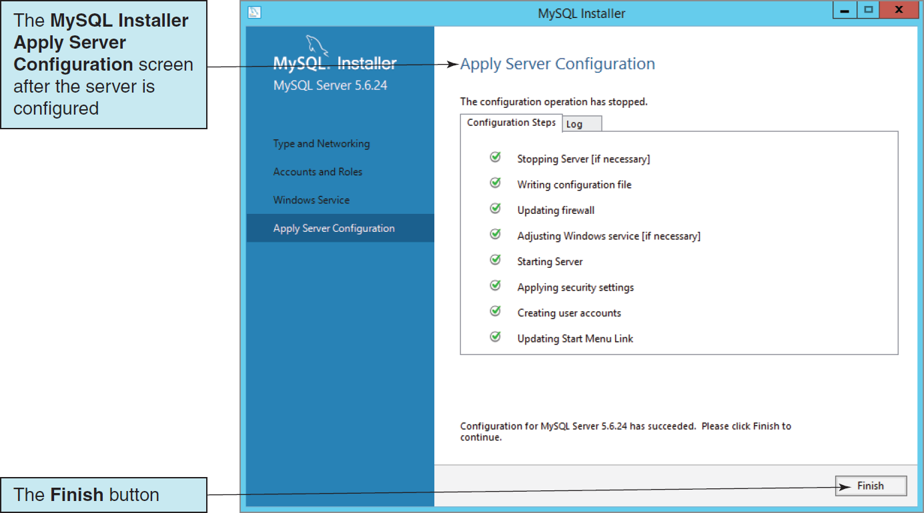
Installing MySQL 5.6 The Completed Apply Server Configuration Page

Slide 18
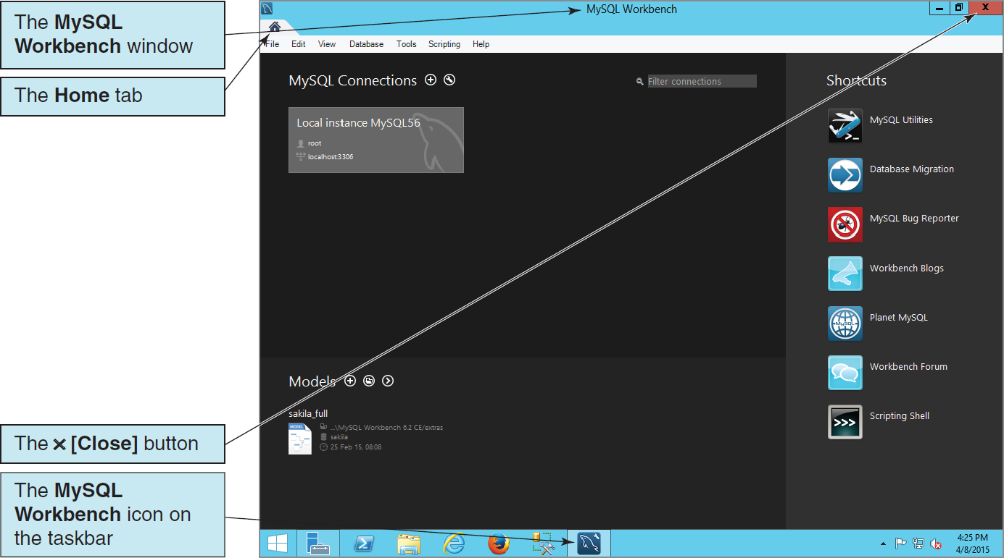
Installing MySQL 5.6 The MySQL Workbench Home Tab
Notes:
Your installation of MySQL will install the current versions of these products, which will probably have different version numbers then shown in the discussion here. That is appropriate, because you always want to have the most current versions of the software installed.
After you have installed MySQL, you should check regularly for updated versions of the MySQL release you are using. For systems running a Windows OS, this functionality is built into the MySQL Installer for Windows, and you should use this utility to check for updates and then update your MySQL installation. Note that the MySQL Installer for Windows checks for updates for all MySQL products, not just MySQL Server.
For non-Windows OS installations, check the version number on the appropriate Downloads page. For example, we are currently using MySQL Community Server version 5.6.24, so when version 5.6.25 is released, we will need to download the new version and install it over the existing installation.
We need to check for updates because these updates are used in lieu of service packs and patches to make sure your installation is as secure as possible. There is no problem installing a newer version of MySQL over an older version of the same release.
For Windows OS installations, the MySQL Installer for Windows can be installed into an existing MySQL setup and can then be used to maintain that installation.

Slide 19
MySQL Storage Engines
Unlike DBMS products like SQL Server 2014 and Oracle Database, MySQL can actually use various database storage engines, each of which stores database table structures and data in a different manner.
MyISAM storage engine
Previous default
Does not support referential integrity
InnoDB storage engine
Preferred, the current default, and always used in this book.
Stores rows in primary key order.
Supports foreign keys and referential integrity.
Supports ACID transactions (see Chapter 9).

Slide 20
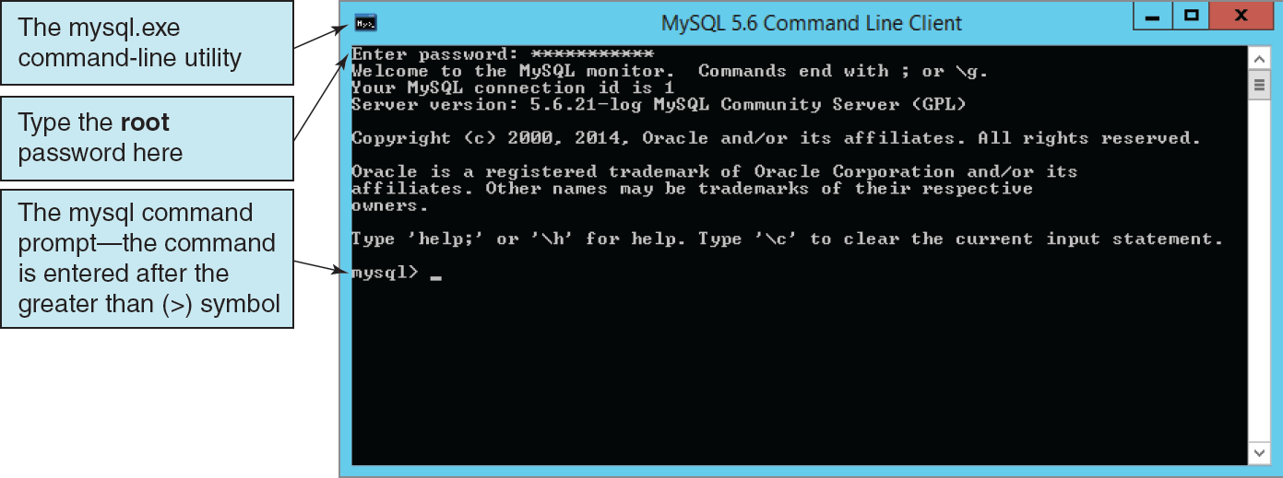
MySQL 5.6 Utilities: MySQL Command Line Client

Slide 21
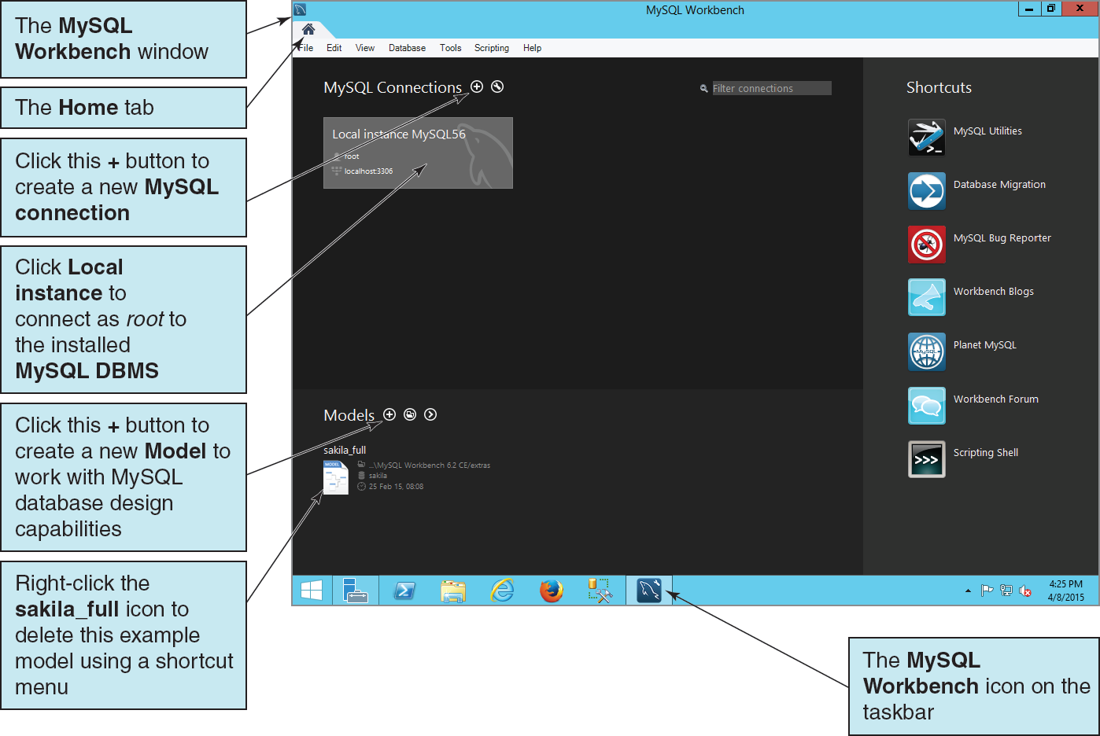
The MySQL Workbench Window
Notes:
The first time you open the MySQL Workbench, you will see an existing model named sakila_full in the Models list. We do not need this model. To delete the sakila_full model:
■ Right-click the EER model name sakila_full in the Models list to display a shortcut menu.
■ In the shortcut menu, click either the Remove Model File from List command (to remove just the sakila_full model from the list) or the Clear List command (to remove all the models from the list).

Slide 22
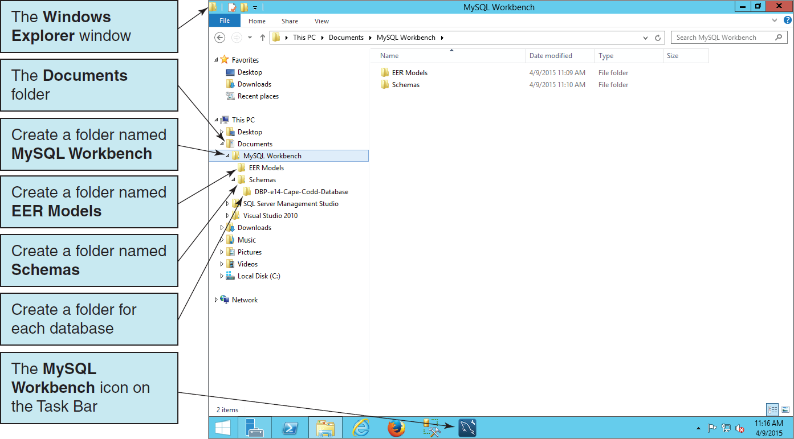
MySQL 5.6 Utilities: Setting up the MySQL Workbench Folders

Slide 23
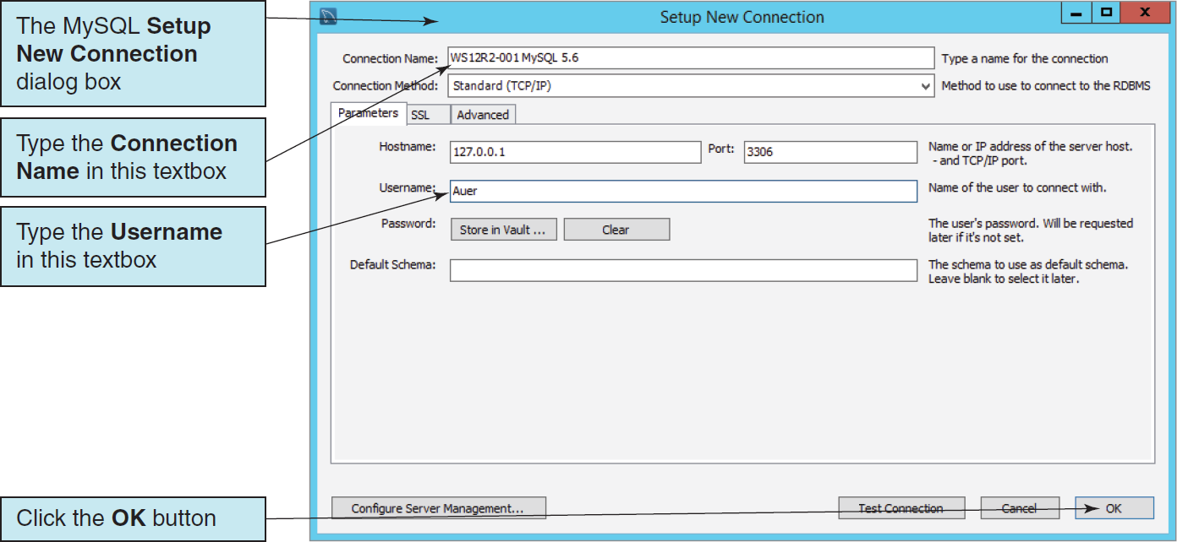
MySQL Workbench The Setup New Connection Dialog Box

Slide 24
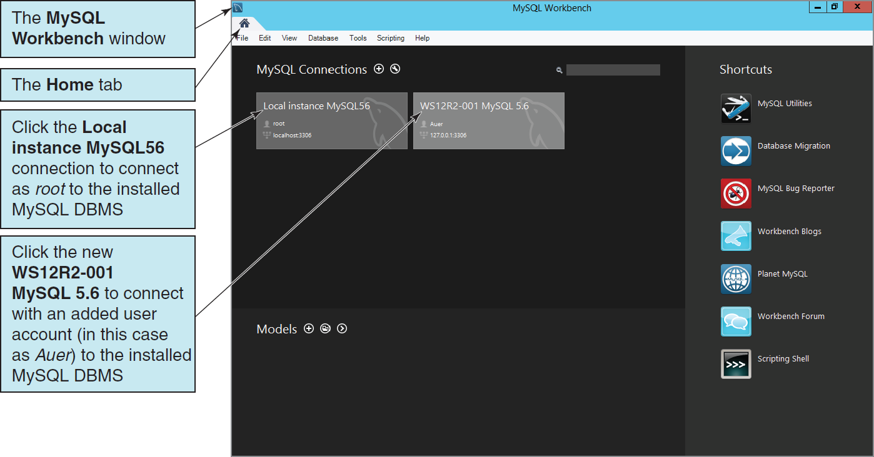
MySQL Workbench The New MySQL Connection in MySQL Workbench

Slide 25
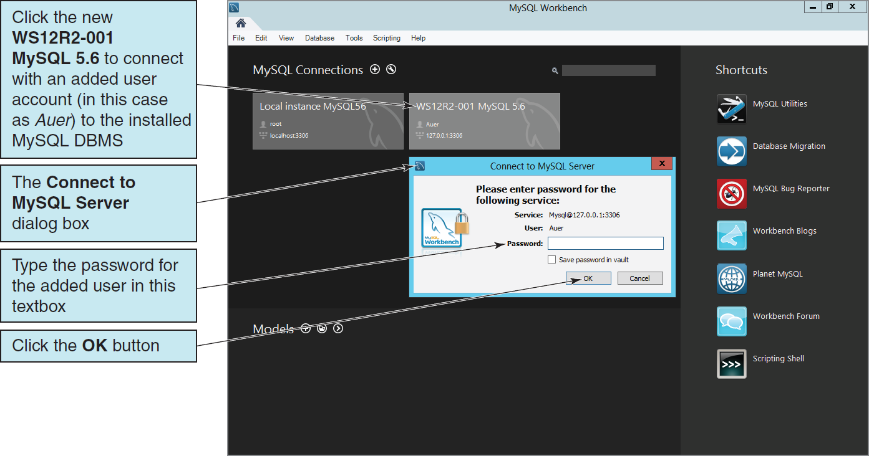
MySQL Workbench The Connect to MySQL Server Dialog Box

Slide 26
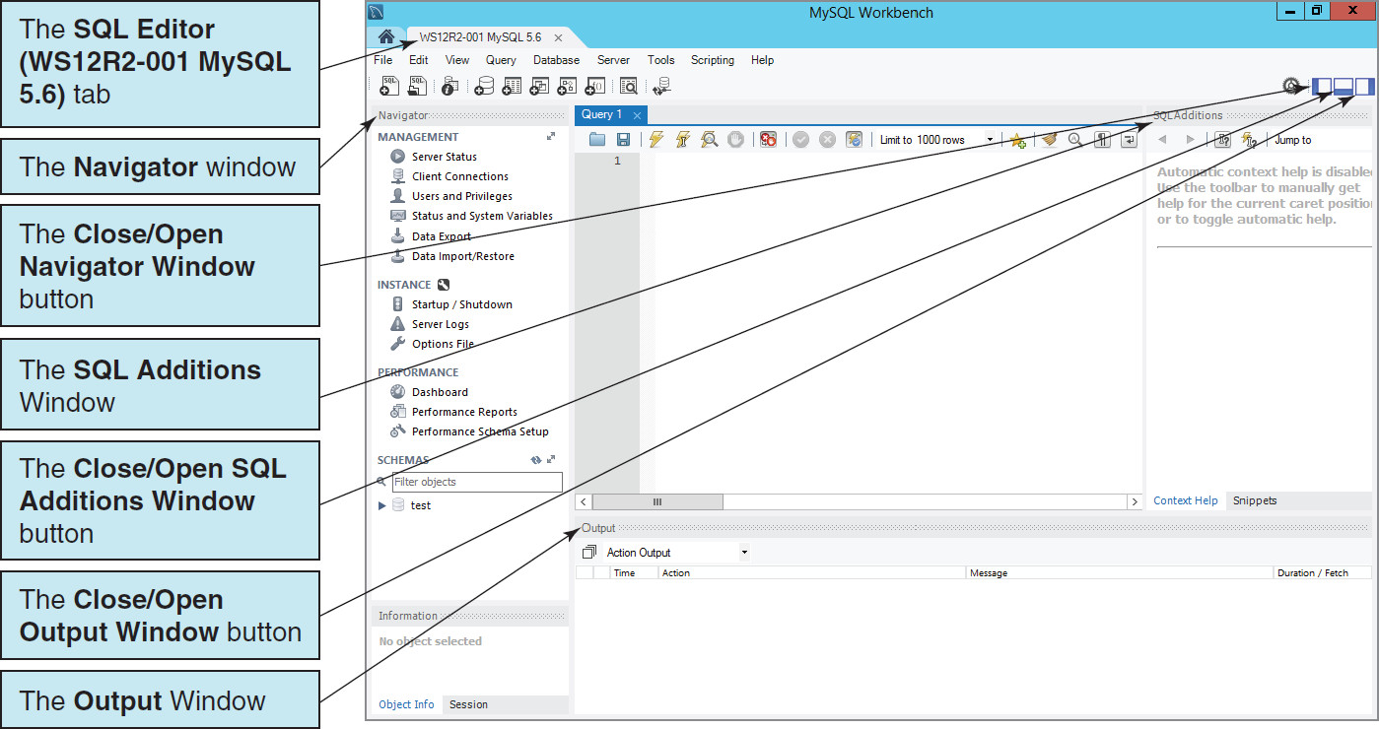
The SQL Editor Window The WS12R2-001 MySQL 5.6 Connection

Slide 27
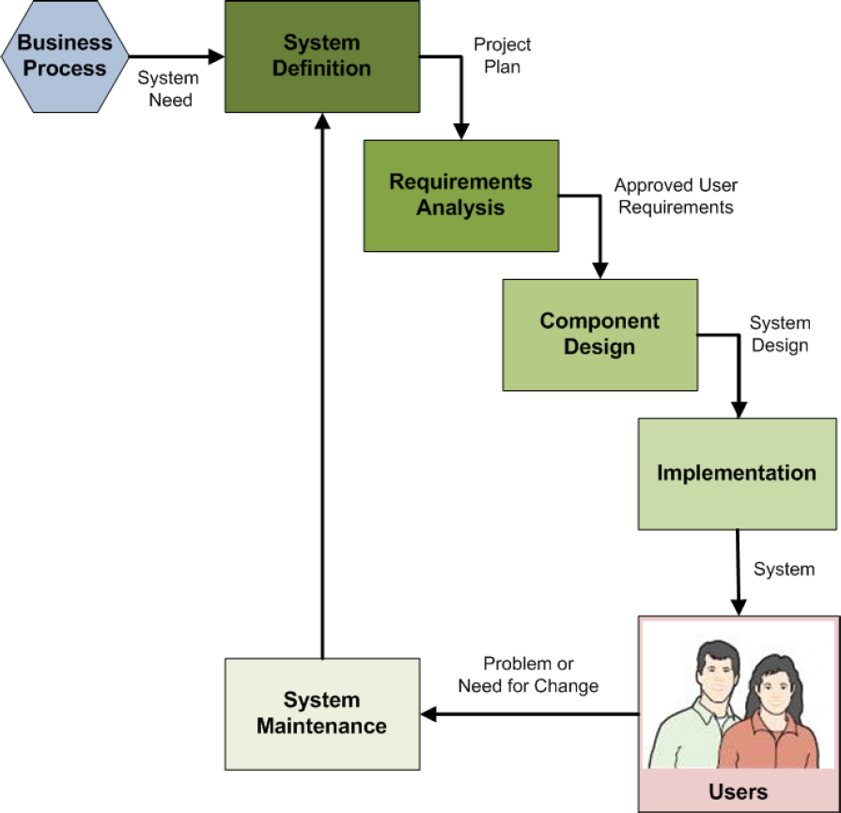
Database Implementation in the SDLC
The systems development life cycle (SDLC) as discussed in Appendix B
Database construction occurs in the implementation step of the SDLC
The final database is part of the final system ready for users to use
Notes:
Books on systems analysis and design often identify three design stages:
■ Conceptual design (conceptual schema)
■ Logical design (logical schema)
■ Physical design (physical schema)
The creation and use of file structure and file organization (including physical storage placement and file characteristics) to store database components and physical records of data are a part of the physical design, which is defined in these books as the aspects of the database that are actually implemented in the DBMS. Besides physical record and file structure and organization, this includes indexes and query optimization.

Slide 28
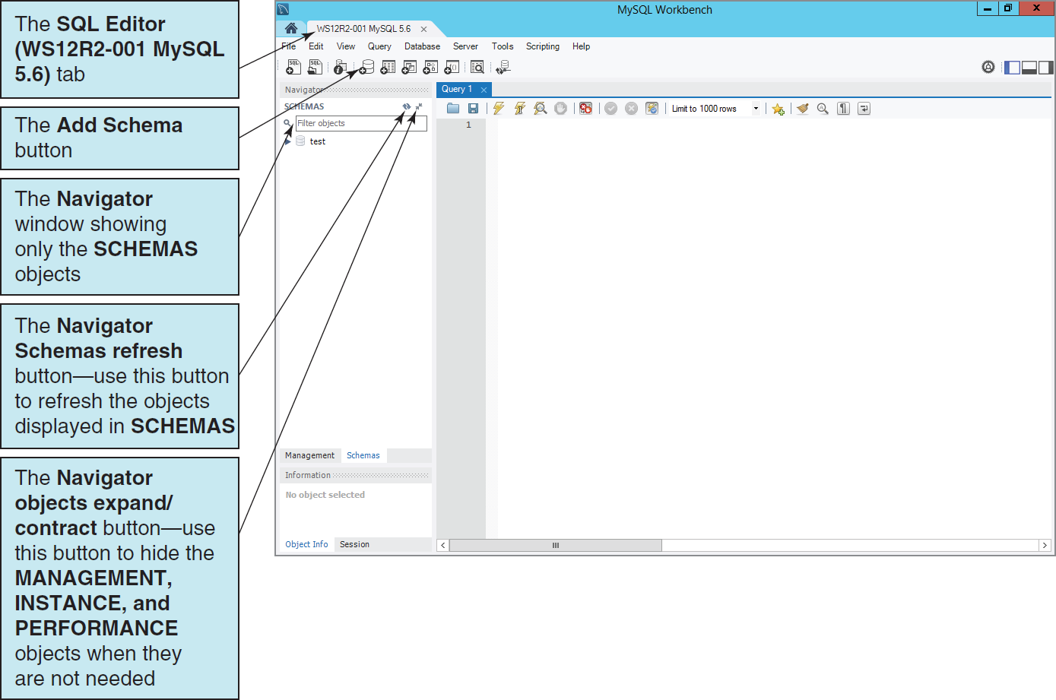
Creating a New Database The Add Schema Button

Slide 29
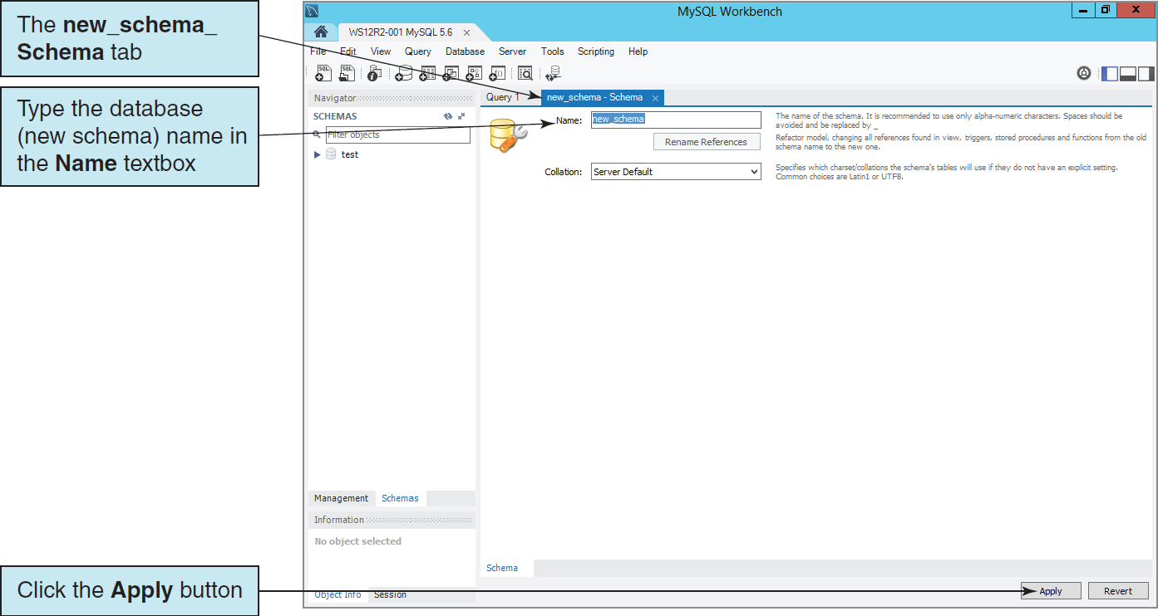
Creating a New Database The new_schema Tab

Slide 30
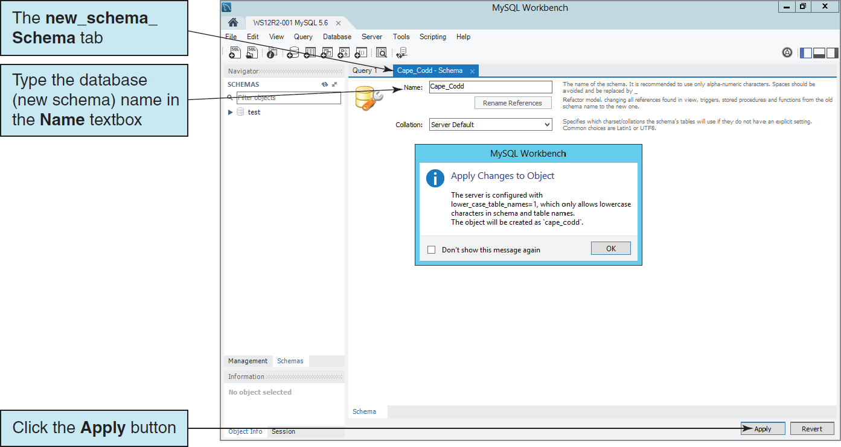
Creating a New Database The Apply Change to Object Warning Dialog Box
By default, MySQL only allows lower case letters in schema names, and will automatically change upper case letters to lower case.

Slide 31
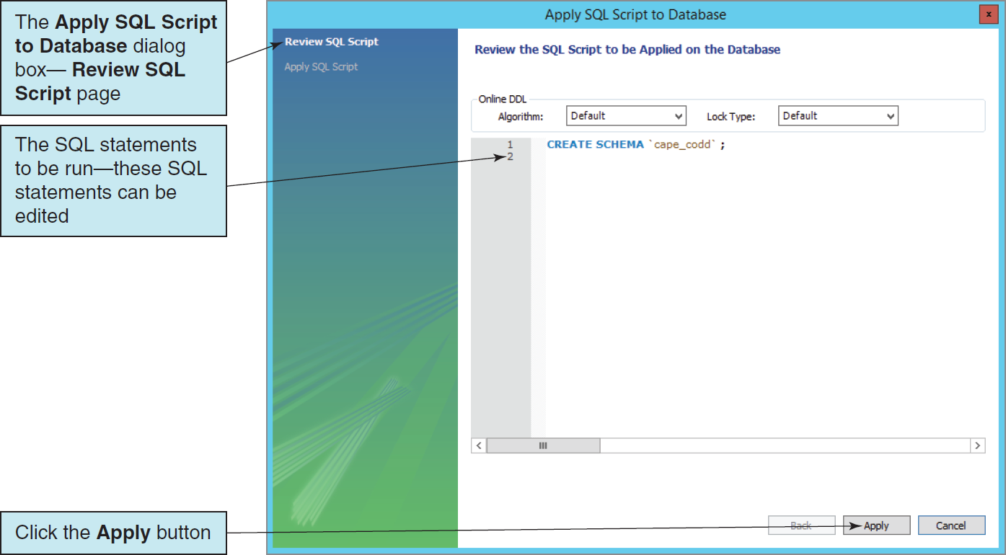
Creating a New Database The Apply SQL Script to Database—Review SQL Script Dialog Box

Slide 32
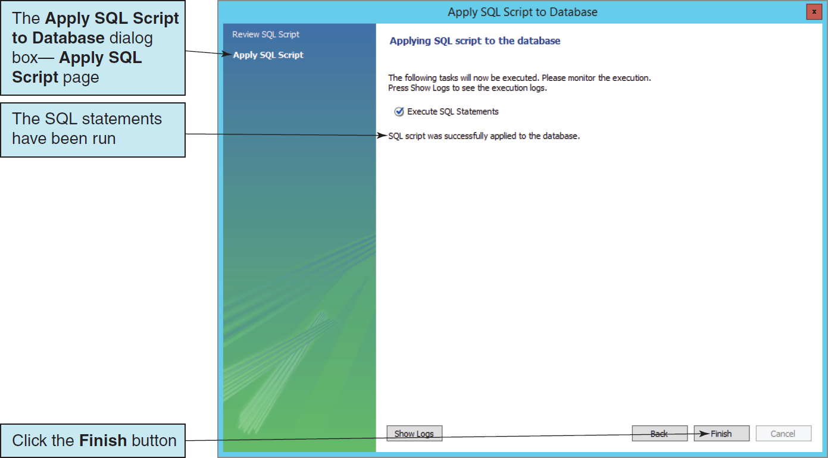
Creating a New Database The Apply SQL Script to Database—Apply SQL Script Dialog Box

Slide 33
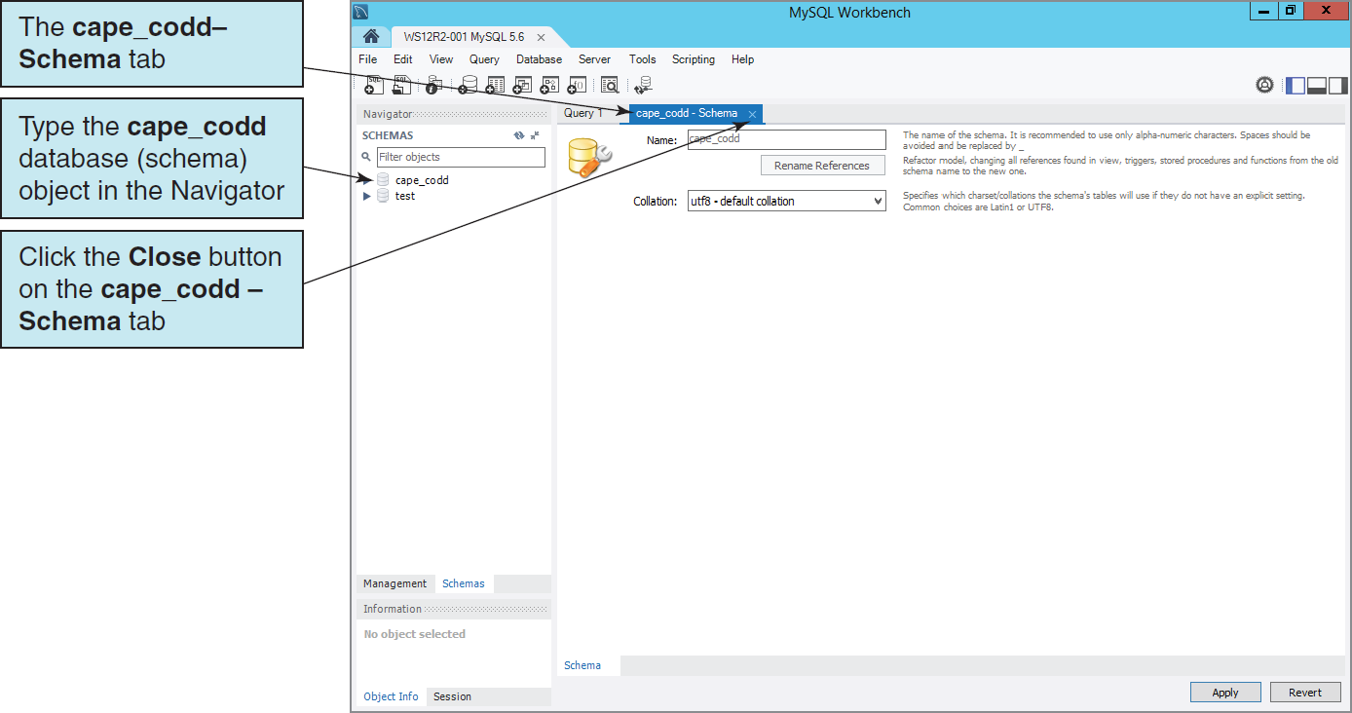
Creating a New Database The New cape_codd Database (Schema) Object in the Navigator

Slide 34
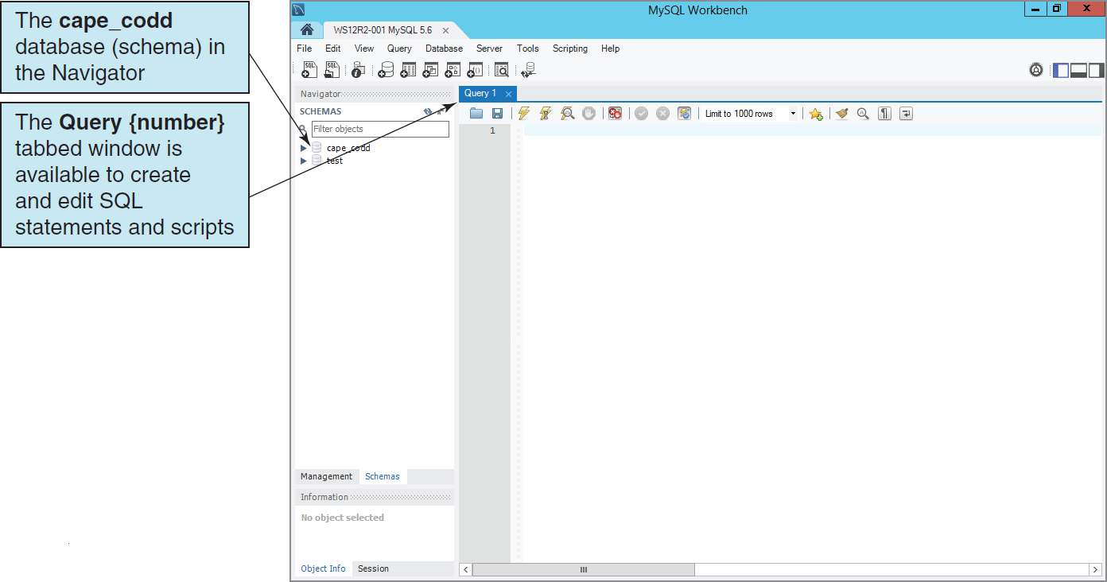
Creating a New Database The New Database Object in the Navigator

Slide 35
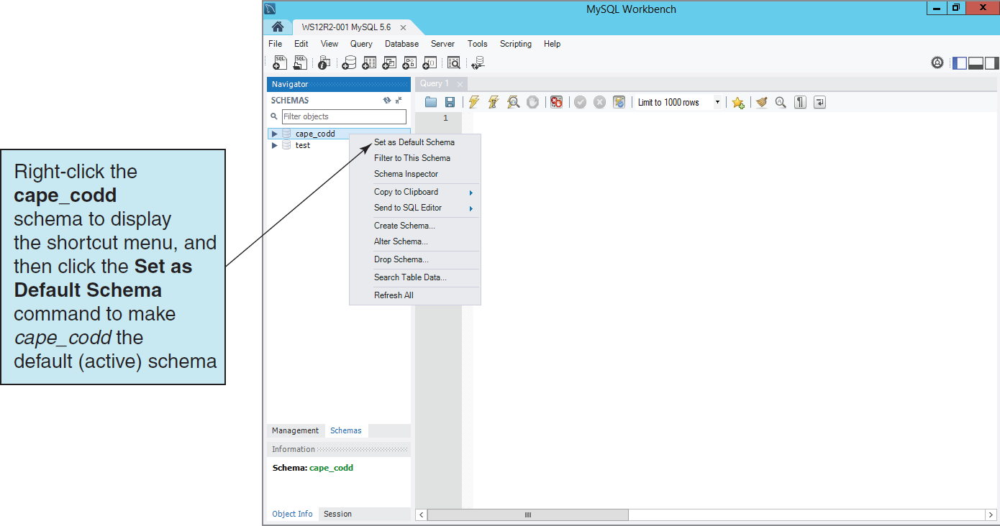
Setting the Default Schema The Set as Default Schema Command

Slide 36
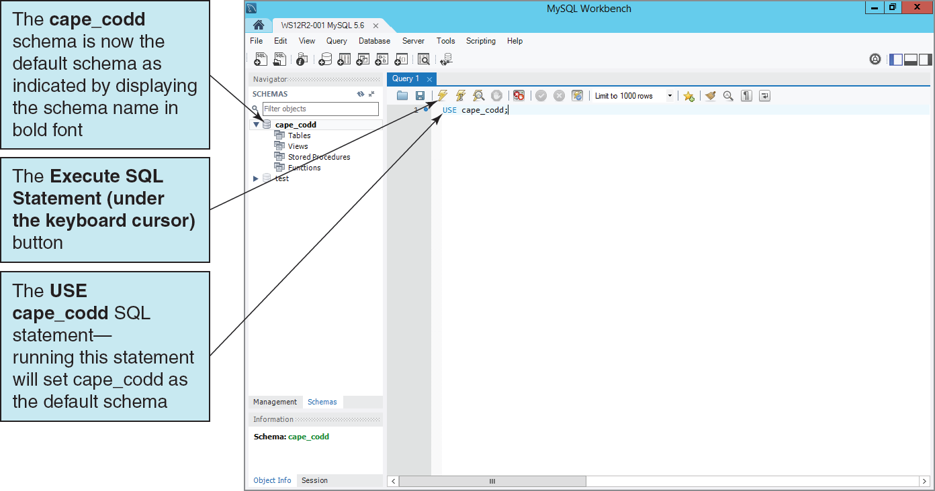
Setting the Default Schema The SQL USE {SchemaName} Statement

Slide 37
SQL Scripts
An SQL script is a plaintext file labeled with the .sql file extension.
An SQL script is composed of one or more SQL statements, which can include SQL script comments.
SQL script comments are lines of text that do not run when the script is executed but are used to document the purpose and contents of the script. Each comment begins with the characters /* (slash asterisk) and ends with the characters */ (asterisk slash). Alternatively, for a single line comment (or a comment at the end of a line), we use # (pound sign) at the start of the comment.

Slide 38
Cape Codd Database Available Online
Another advantage of SQL scripts is that we can use scripts written by others.
Versions of the complete Cape Codd database are available in the downloadable Student Files available at:
http://www.pearsonhighered.com/kroenke/
These include versions for:
Microsoft Access 2013
Microsoft SQL Server 2014
Oracle Database 12c and Oracle Database XE
MySQL 5.6
We recommend you actually run all material in a live database!

Slide 39
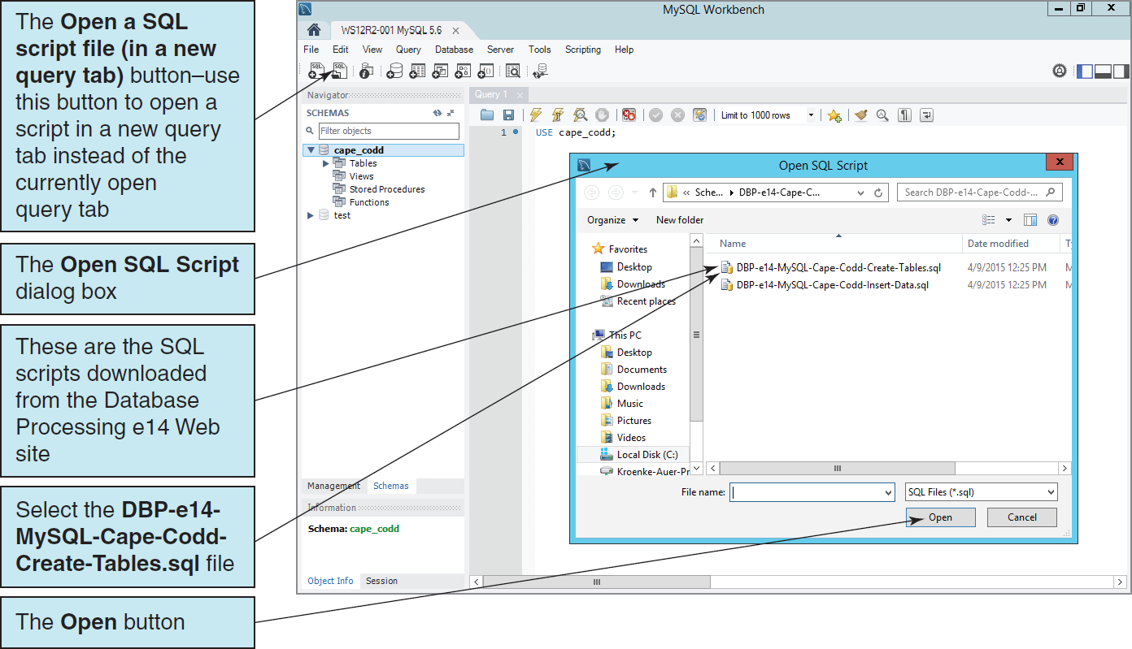
Using Existing SQL Scripts Opening the Existing SQL Script

Slide 40
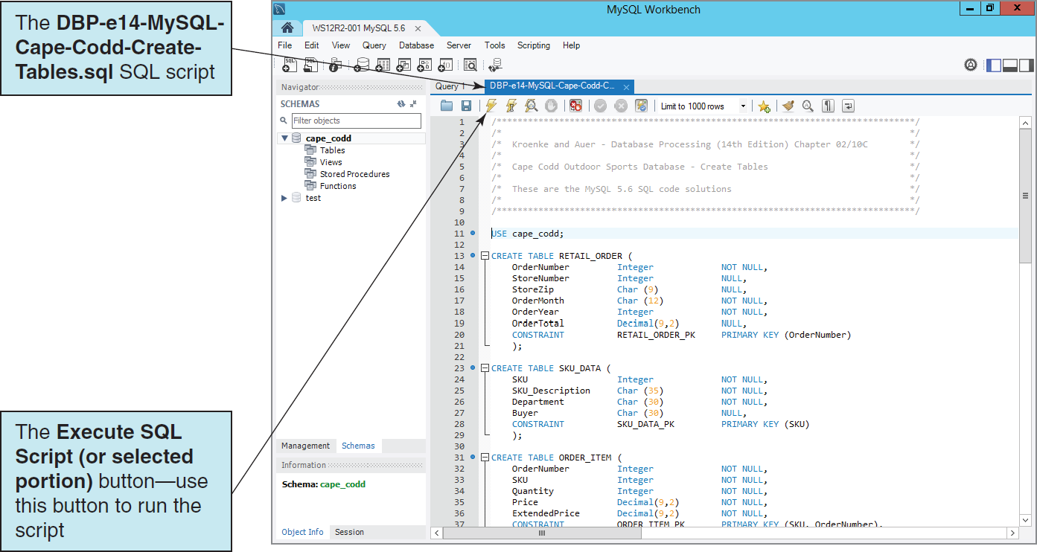
Using Existing SQL Scripts II The Cape Codd Database Create Tables Script

Slide 41
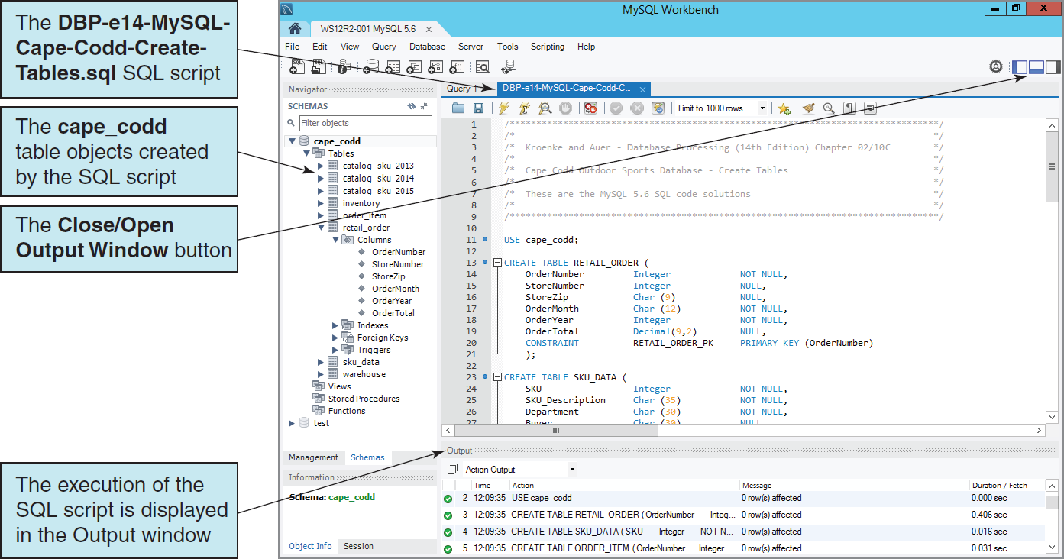
Using Existing SQL Scripts III The Cape Codd Database Table Objects in the Navigator

Slide 42
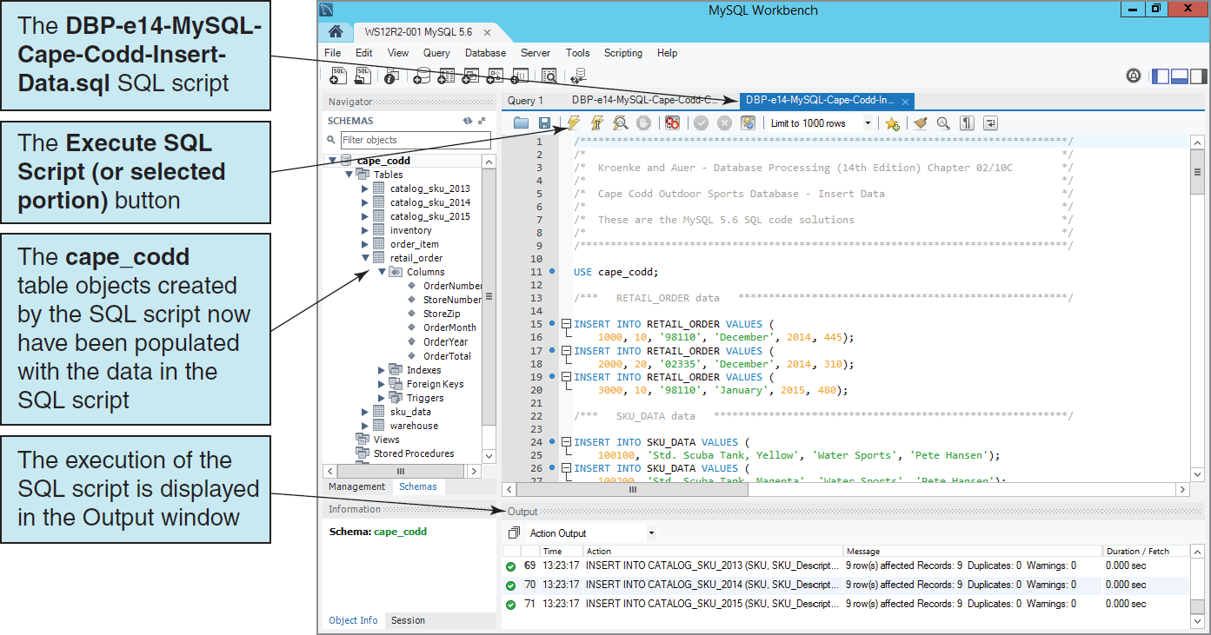
Using Existing SQL Scripts III Populating the Cape Codd Database Tables

Slide 43
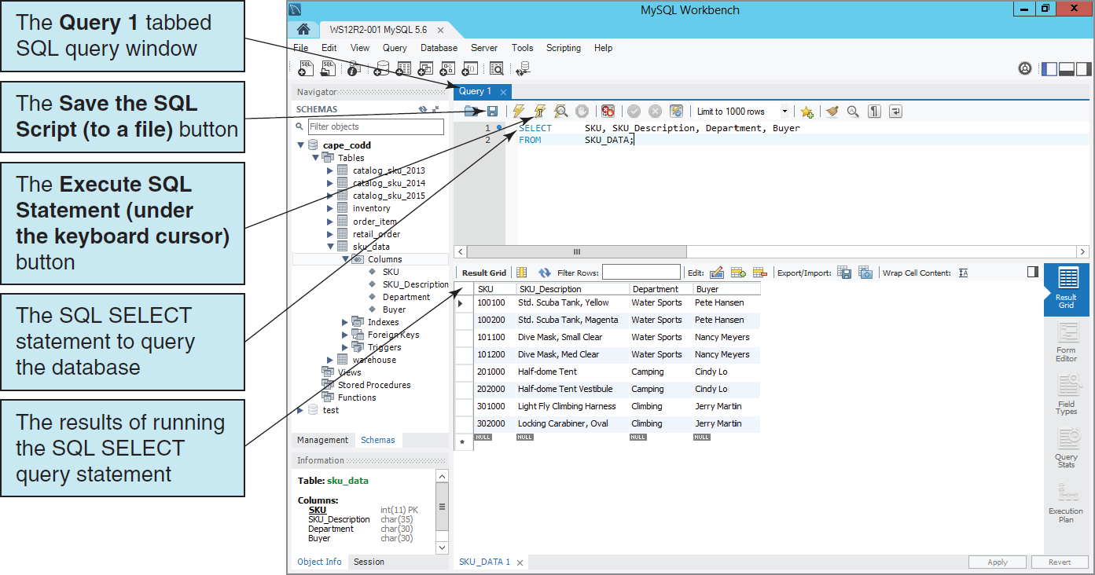
Querying the Cape Codd Database

Slide 44
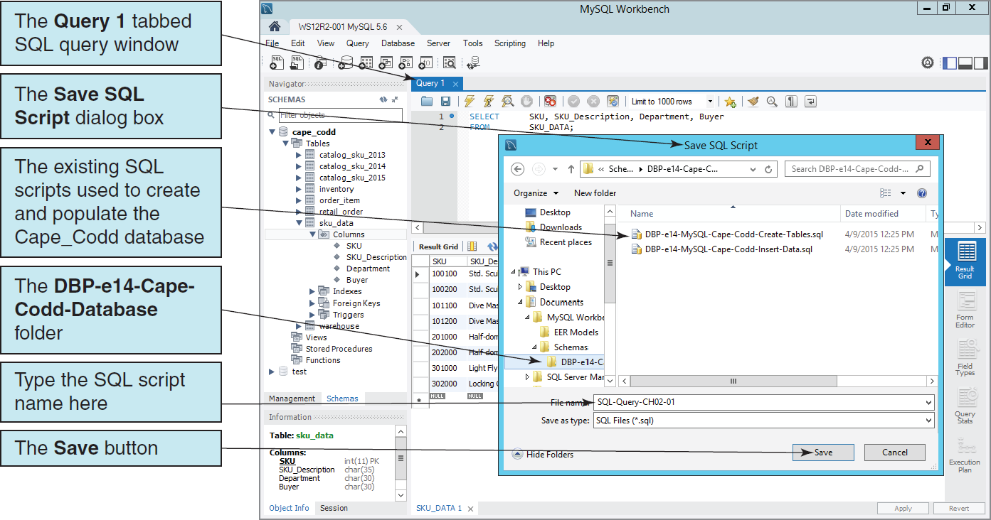
Saving the SQL Query as an SQL Script

Slide 45
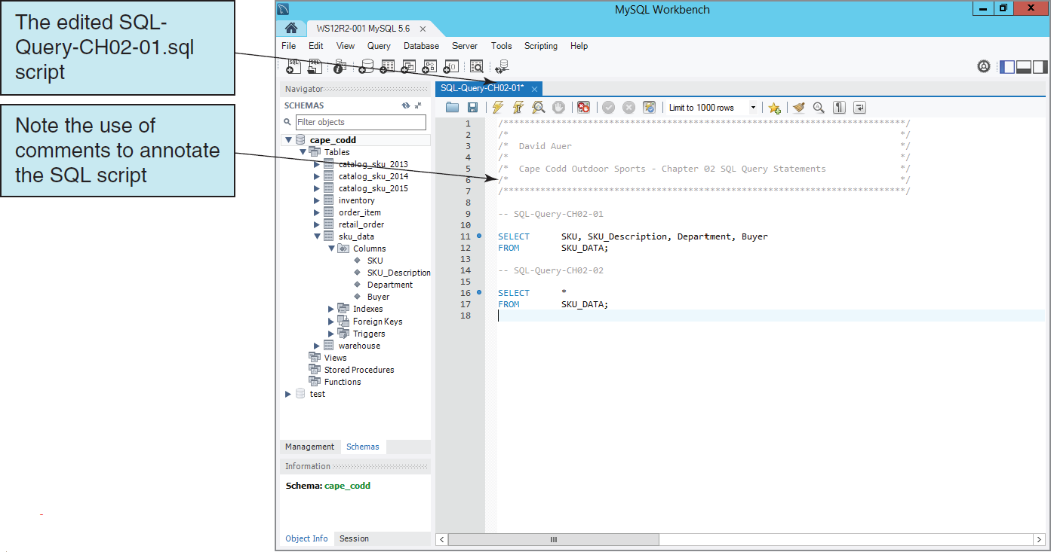
Using a Single SQL Script to Store Multiple SQL Commands The Edited SQL Script

Slide 46
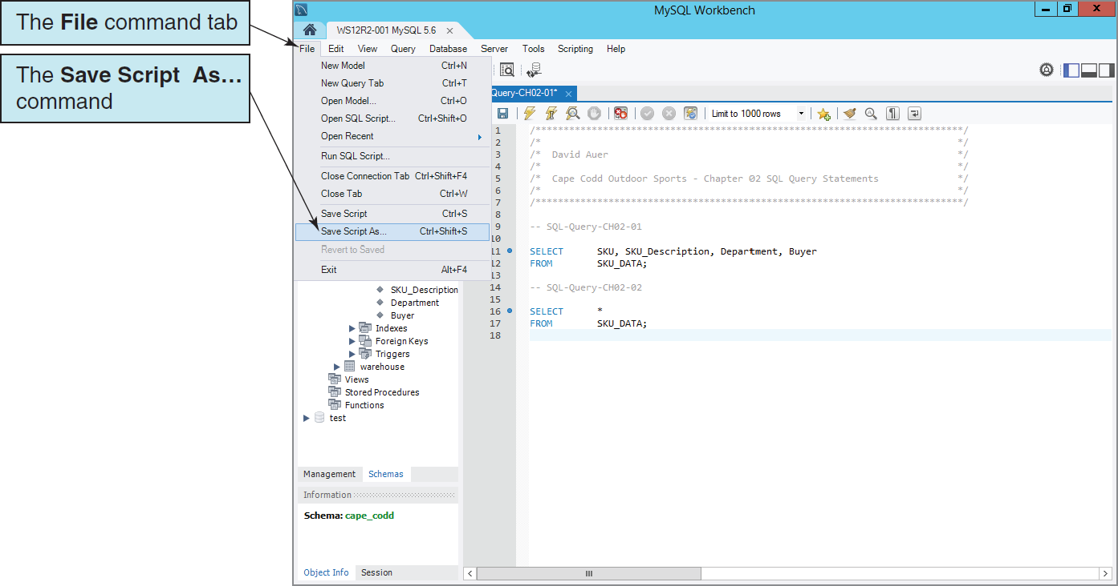
Using a Single SQL Script to Store Multiple SQL Commands The File | Save Script As . . . Command

Slide 47
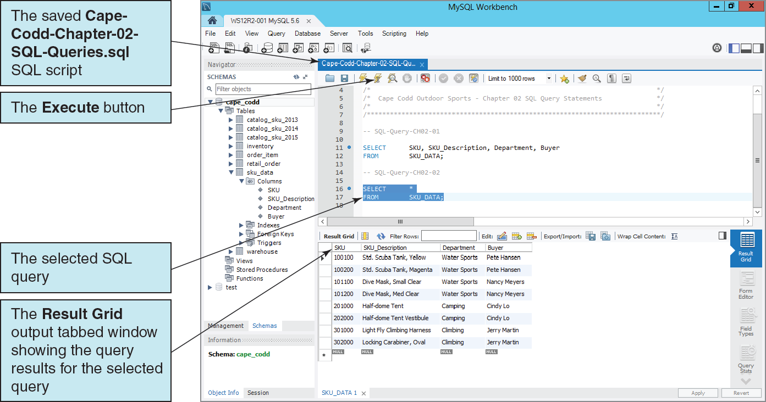
Using a Single SQL Script to Store Multiple SQL Commands The Renamed SQL Script
Notes:
At this point you have covered all the material about MySQL 5.6 that you need to work with the SQL query statements in Chapter 2. If you worked through this material because of the directions in the using SQL in Oracle MySQL 5.6 section on pages 58–61, you should return to that section at this time and continue your work on SQL query statements.
Use the new Cape-Codd-Chapter-02-SQL-Queries.sql script to store all your work in Chapter 02—that will be much easier and more efficient than storing a separate SQL script for each query!

Slide 48
David Kroenke and David Auer Database Processing Fundamentals, Design, and Implementation (14th Edition)
End of Presentation:
Chapter Ten C Part 1

Slide 49

All rights reserved. No part of this publication may be reproduced, stored in a retrieval system, or transmitted, in any form or by any means, electronic, mechanical, photocopying, recording, or otherwise, without the prior written permission of the publisher. Printed in the United States of America.

